Slide 1
Claims Assignment
Prepared by Nick Arquette (07/16/2020)

Slide 2
Agenda
Challenge Overview
Data Overview
Provider Insights
Modeling
Paid Versus Unpaid Info
Data Cleaning
Evaluation and Review
Summary
Appendix (Auto-ML)
Strategy
Feature Importance
Auto-ML (h2o)
Problem Statement
General Procedure Questions
Pre-processing

Slide 3
Assignment Challenge
What is correlated with Unpaid procedure claims?

Slide 4
Data Overview
Total Claims
Procedure Claims (CANCER)
472,559 Total Rows
46,988 unique claims
~5 lines per claim (average)
10,691 unique claims
In-Network Procedure Payments
$ 2,471,220.96
Top 5 Paid Procedures
J2405, J2501, J7030, J1170, J1644
Cancer Related Procedure
Notes:
J2405 – Ondansetron Hydrochloride (helps with reducing nausea, and vomiting in cancer patients)
J2501 – Paricalcitol (prevents parathyroid hormone) – commons in patients with long-term kidney disease
J7030 – Saline Solution
J1170 – Hydromorphone (relieve pain)
J1644 - Heparin Sodium (anticoagulant) – prevents clotting for patients during open heart surgery or dialysis

Slide 5
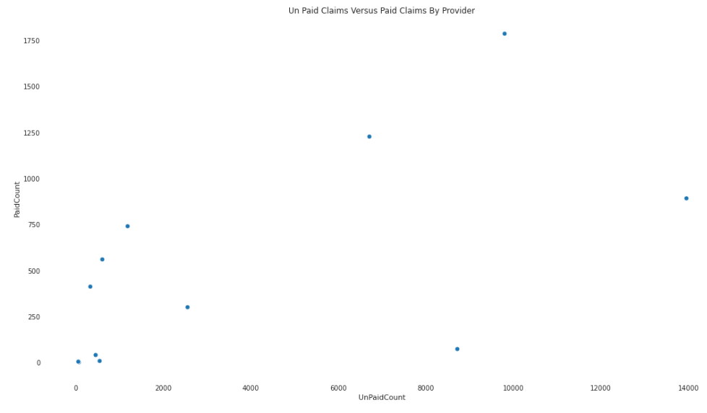
Provider Unpaid VS. Paid

Slide 6
Provider Insights
Interpretation:
There is a positive correlation between the number of paid claims versus un-paid claims meaning that that are at least double the amount of unpaid claims for every one paid claims.
Concerns:
Why are there some many unpaid claims?
Why is different for one provider versus another?
Loss in revenue for organization.
Questions:
What is the source of the problem (e.g. documentation, provider workflow, etc.)?
Are there any protocols in place to review this with management on a weekly basis?
What timeframe are we looking at?
Are the numbers better for a different timeframe?
Should there be an unpaid percentage threshold?

Slide 7
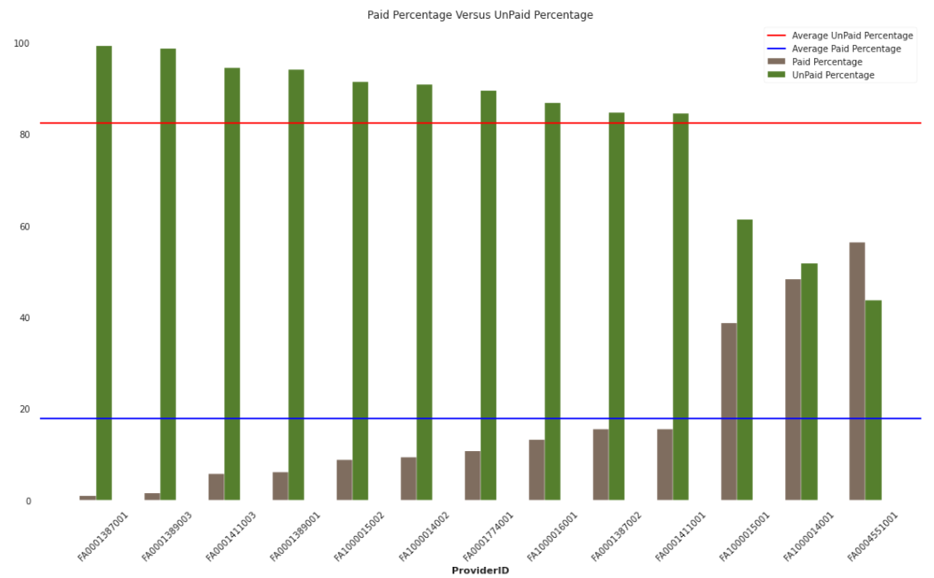
AVERAGE UNPAID (82.31 %) AVERAGE PAID (17.69 %)
Notes:
Average Paid percentage is 17.693456299234207
Average Unpaid Paid Percentage is 82.3065437007658'

Slide 8
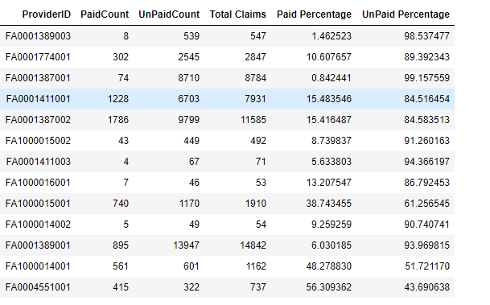
AVERAGE UNPAID (82.31 %) AVERAGE PAID (17.69 %)
Notes:
Average Paid percentage is 17.69
Average Unpaid Paid Percentage is 82.31

Slide 9
Modeling
Predictive Output
Yes (Unpaid) or No (Paid)
Modeling Algorithm
Supervised Classification Algorithms
Base Model
Logistic Regression
Competitor Models
Random Forest, Xgboost, Lgboost
AutoML = h20
Why?
Appropriate to solve desired output
Can handle different types of data (numeric and categorical)
Can be visually interpreted by client
Includes feature importance
Addresses the problem of overfitting

Slide 10
Dropped columns
Claim.Number
Claim.Line.Number
Member.ID
Claim.Subscriber.Type
Subscriber.Payment.Amount
Place.Of.Service.Code
Why?
Columns didn’t add predictive value (e.g. Claim.Number) and had high cardinality
Not enough data (place.of.service.code)
Notes:
Place.Of.Service.Code had 2 with a value of 11 and 51027 null values

Slide 11
DATA Pre-Processing
Sklearn Pre-processing
Numeric Features
Median Imputation
Scaled (Standard Scaler)
Categorical Features
Constant Imputation (‘missing value’)
One Hot Encoding
Why?
Models need all feature data to be in a numerical form
Numerical features need to be put into a standard scale
Missing data needs to be imputed so that information is not lost
Notes:
Place.Of.Service.Code had 2 with a value of 11 and 51027 null values

Slide 12
Modeling evaluation
Fit Based Model
Compare Base to Competitor Models using performance metrics (Mean Squared Error, Accuracy, AUC, etc.)
Tune Models to determine best parameters
Perform Cross-Validation using final parameters (e.g. 5-folds)
Why?
Models parameter need to be tuned appropriately selected
Cross Validation will help with estimate how the model will perform on unseen data
Notes:
Place.Of.Service.Code had 2 with a value of 11 and 51027 null values

Slide 13
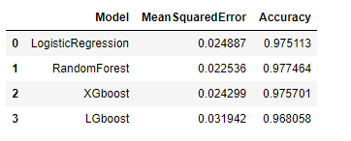
MODEL Results
Best Model
Random Forest
MSE = .0222536
Accuracy = .977
Notes:
Place.Of.Service.Code had 2 with a value of 11 and 51027 null values

Slide 14
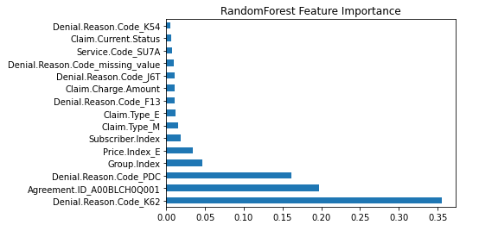
Feature IMPORTANCE for Best Model
Notes:
Place.Of.Service.Code had 2 with a value of 11 and 51027 null values

Slide 15
Feature IMPORTANCE Summary
Top 4 (~ 76 % of importance)
Denial Reason K62
Procedure Exceeded Max Units Allowed Per Date
Agreement ID - A00BLCH0Q001
Would want to understand the feature better
What agreement is this and why is it a problem
Denial Reason PDC
Billed amount is higher than the maximum payment insurance allows
Group Index
Would want to understand this feature better.

Slide 16
Appendix
Additional Methods (Auto-ML)

Slide 17
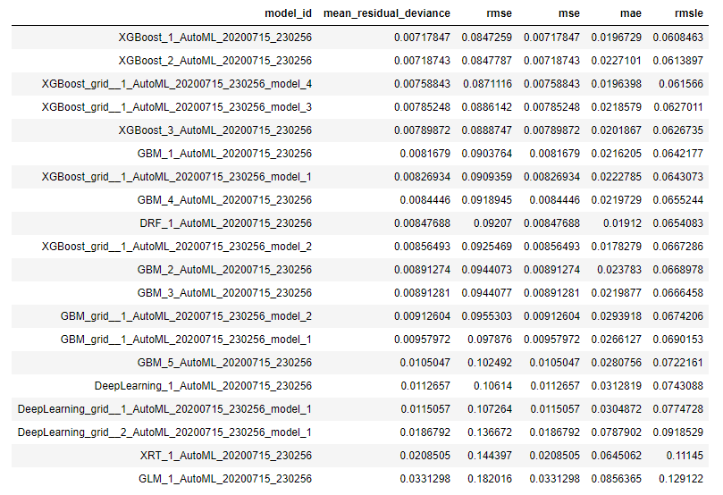
Auto-ML Model Evaluation

Slide 18
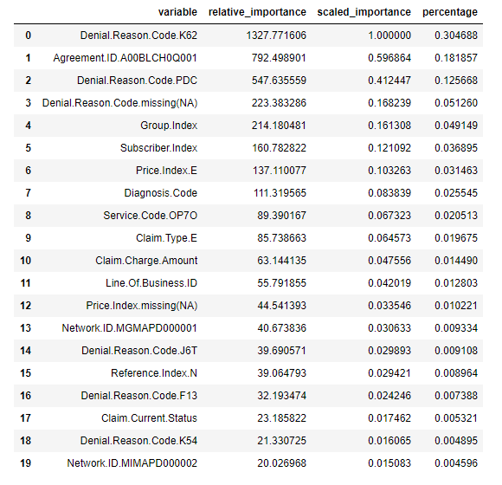
Auto-ML Feature Importance (XgbOOST)

